Slide 1
Arduino Lab 4 : Temperature Sensor , LCD and Soldering
Asst. Prof. Dr.Sumek Wisayataksin
Faculty of Engineering
King Mongkut’s Institute of Technology Ladkrabang

Slide 2
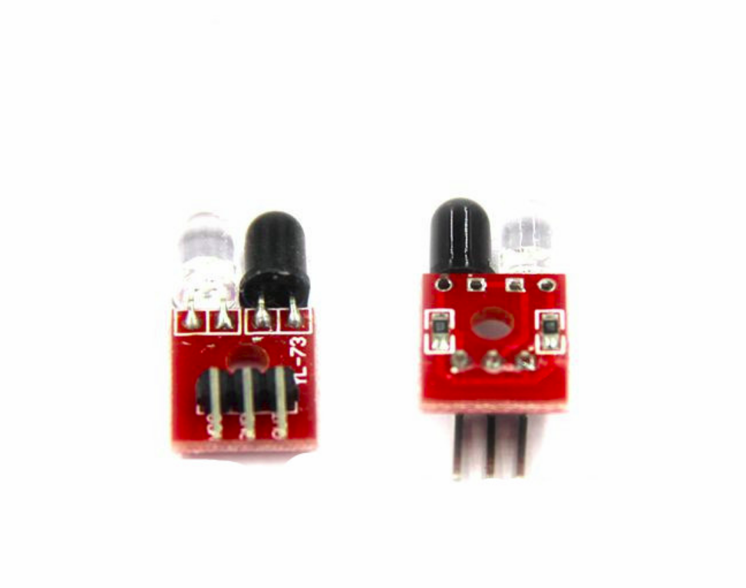
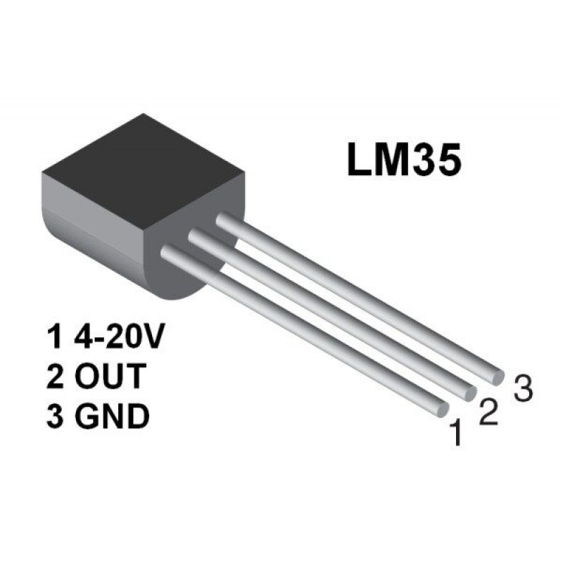
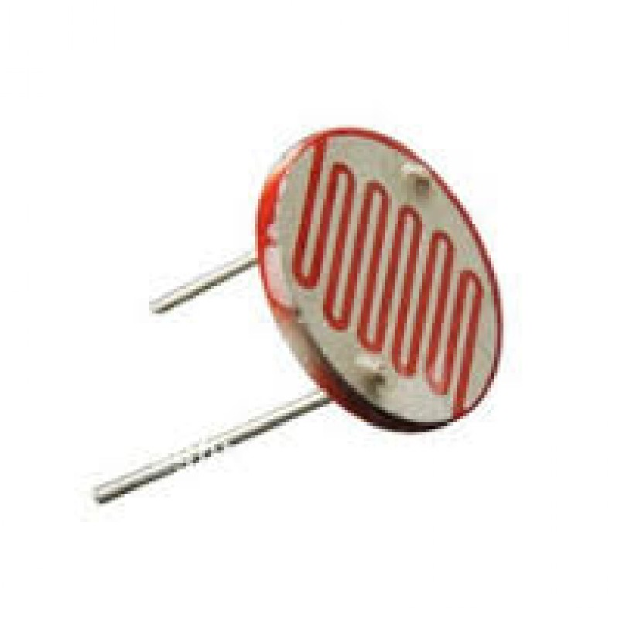
Sensor
A Sensor converts the physical parameter (for example : temperature, blood pressure, humidity, speed, etc.) into a signal which can be measured electrically.
Light Dependent Resistor
Temperature Sensor
Infrared Sensor

Slide 3
Light Sensor
Light-Dependent Resistor (LDR) : The resistance will decrease according to the light intensity. It can be 15Mohm when no light and become 15 Kohm when light detected.
Light Dependent Resistor

Slide 4
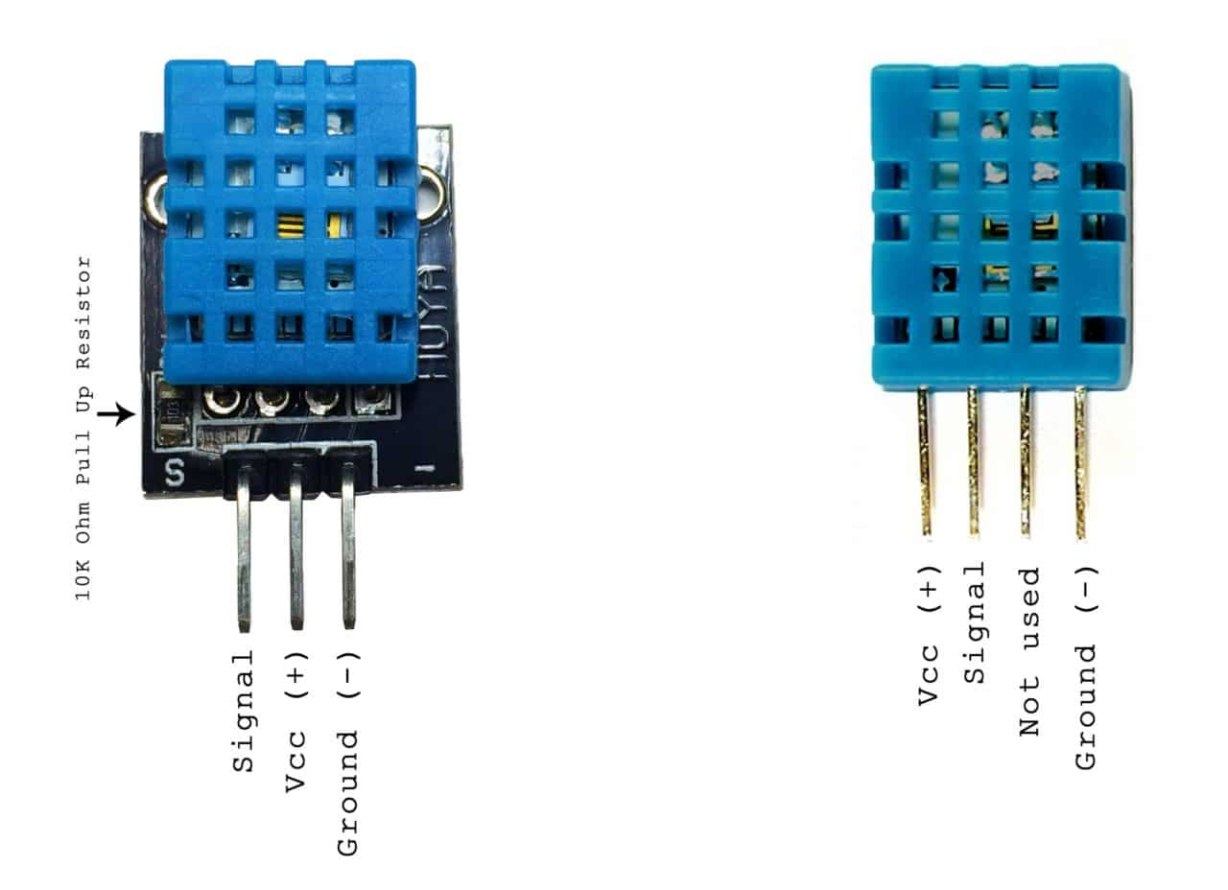
Temperature Sensor
LM35 will increase 10mV every 1c.
For example : 0v at 0c
250mv at 25c

Slide 5
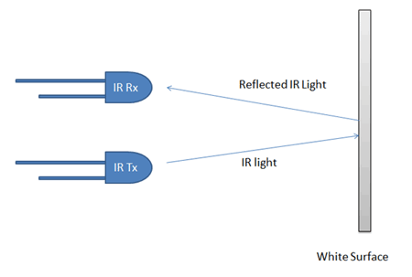
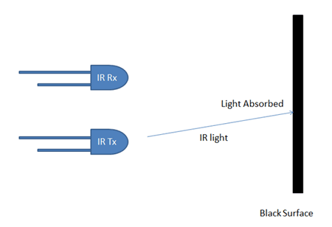
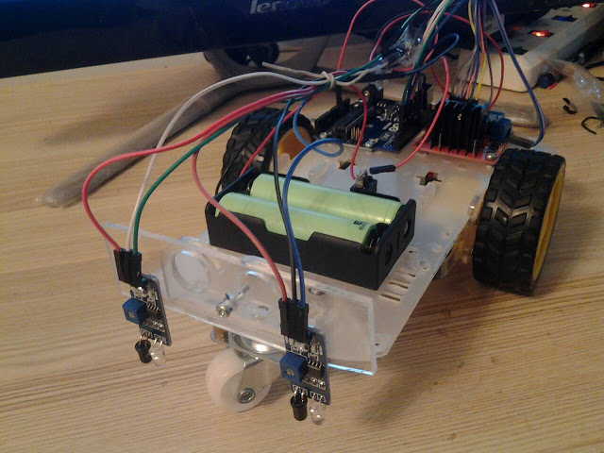
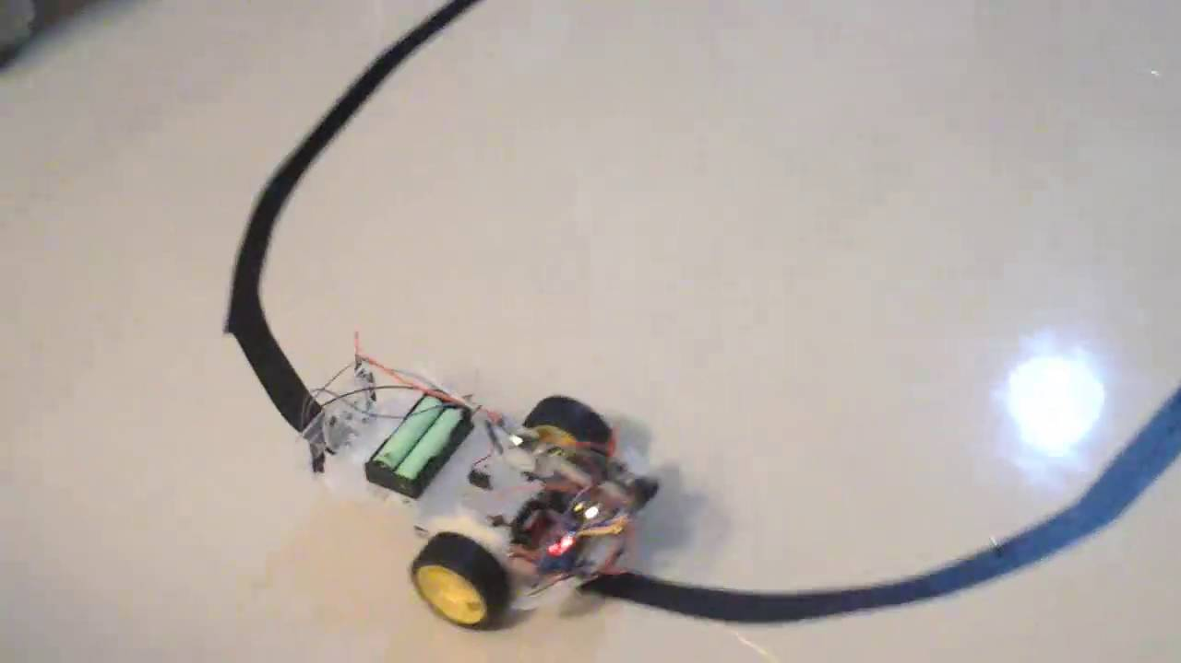
Infrared Sensor
Notes:
We can check the distance by using VST operations. This will allow the card to turn automatically with some coding.

Slide 6
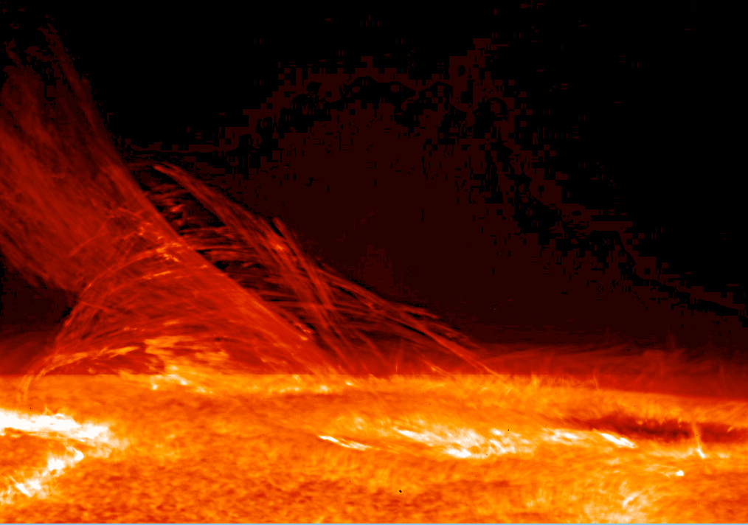
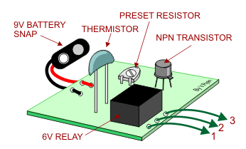
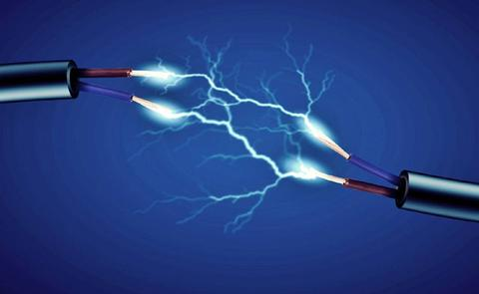


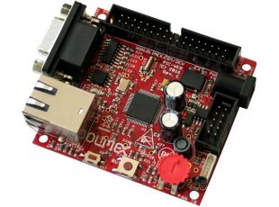
How to connect sensor to microprocessor
Electric Voltage/Current
(Analog)
Binary Representation
(Digital)
Heat
Heat Sensor
Analog World
Digital Signal Processing
Digital World
Electric Voltage/Current
(Analog)
Binary Response
(Digital)

Slide 7
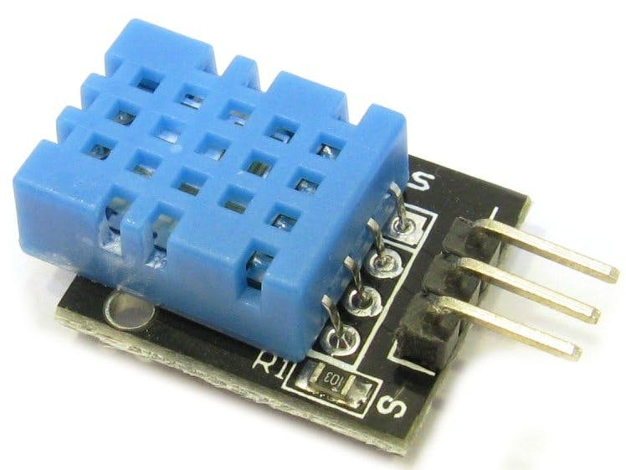
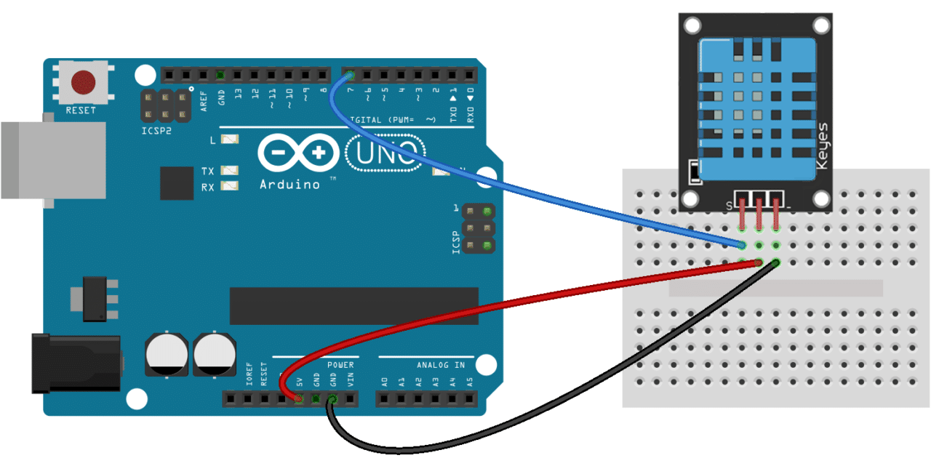
DHT11 Temperature Sensor
Digital-output relative humidity & temperature sensor.

Slide 8
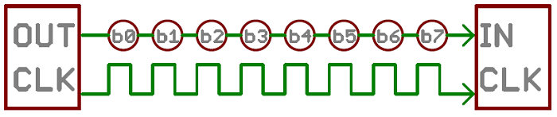
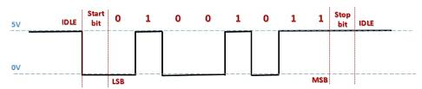
Serial Communication
serial communication is the process of sending data one bit at a time, sequentially, over a communication channel or computer bus.
0b11010010 = 0xD2 = 210
BIN
HEX
DEC

Slide 9
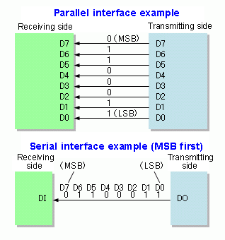
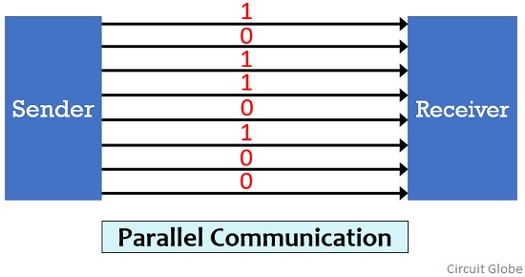
Parallel Communication
parallel communication is a method of conveying multiple binary digits (bits) simultaneously.
0b10110100 = 0xB4 = 180

Slide 10
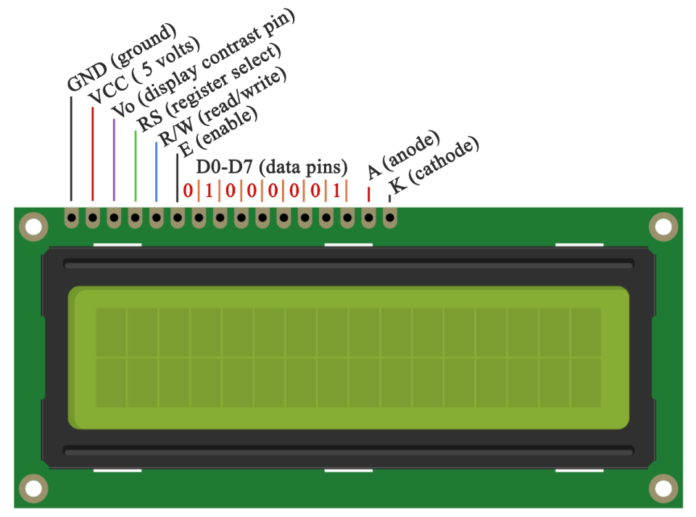
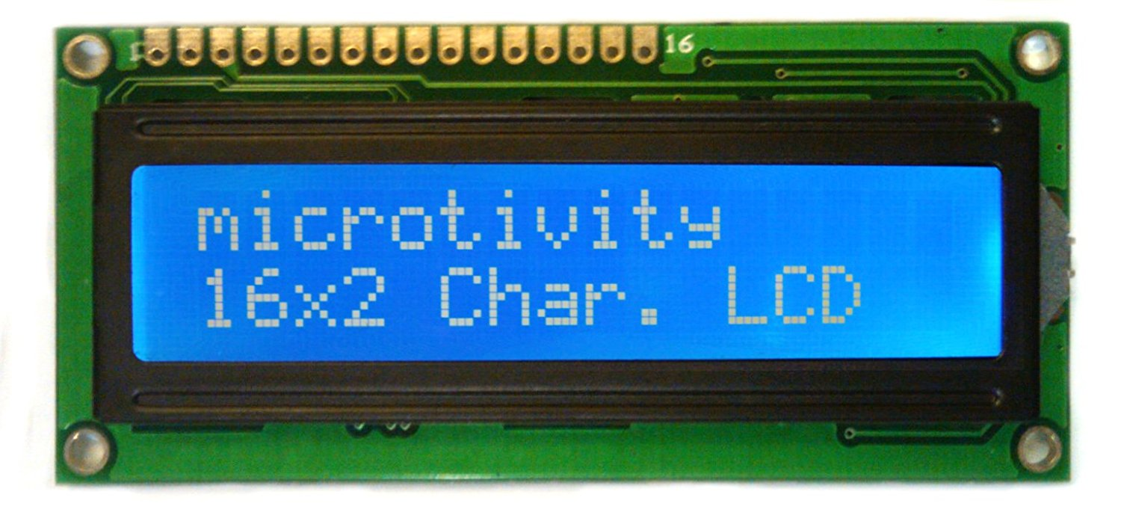
LCD Display
It is a simplest display with 16 Character x 2 Line.
Easy to Control using a parallel port.

Slide 11
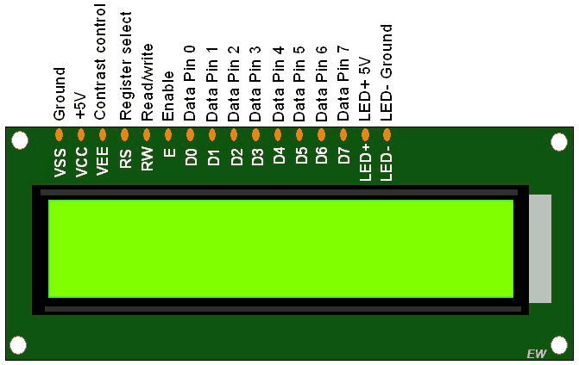
LCD Display
E : Enable
D7-D0 : Parallel Data
LED+/- : Backlight
VSS : GND
VCC: 5V
VEE : Contrast Adjust
RS : Register Select
RS = 0 : Command
RS = 1 : Data
RW : Read/ Write
RW = 0 : Write

Slide 12
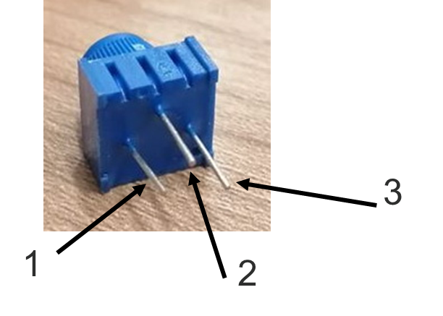
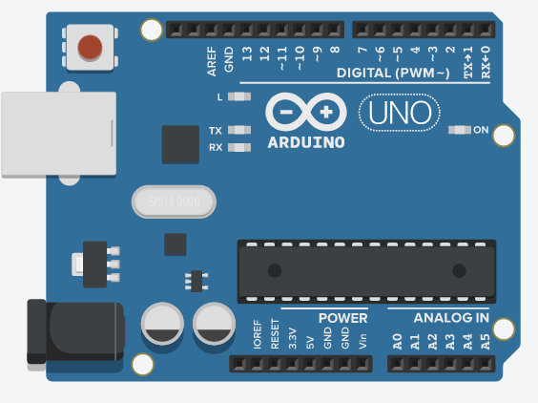
Lab 4.1 : Thermometer
Connect DHT22 and LCD to Arduino as shown below.
GND
5V
GND 5V 12 GND 11 5 4 3 2 5V GND
7
5v
GND

Slide 13
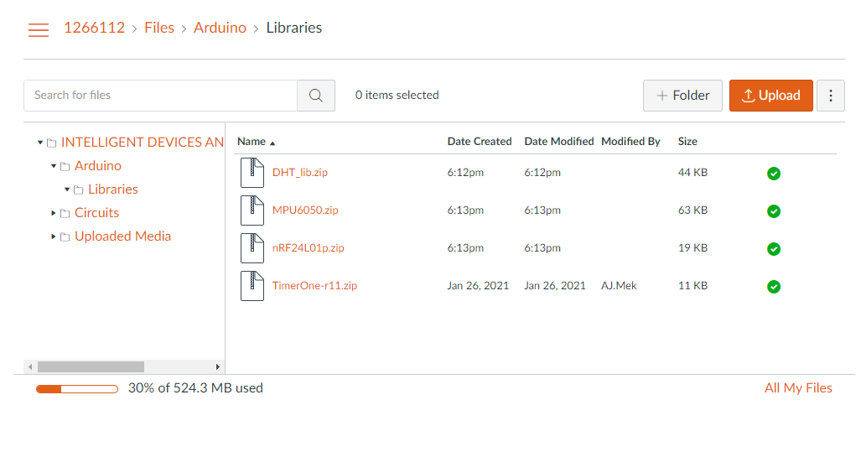
Lab 4.1 : Thermometer
Install DHT22 Library go to canvas and copy DHT_lib.zip
Download and Unzip

Slide 14
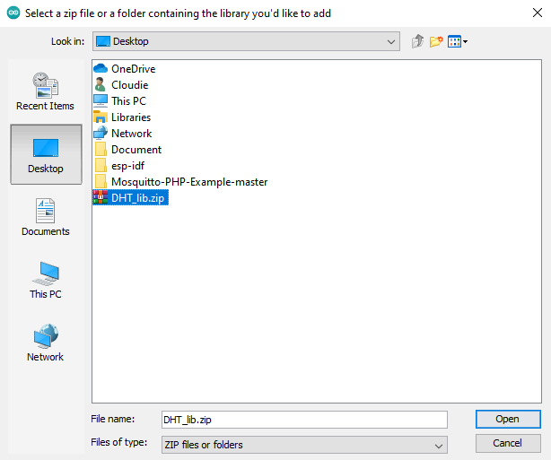
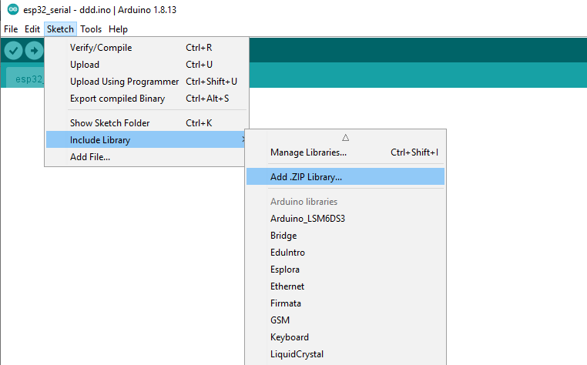
Lab 4.1 : Thermometer
Install the Library
Add .ZIP Library
Select downloaded file

Slide 15
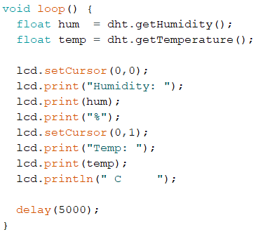
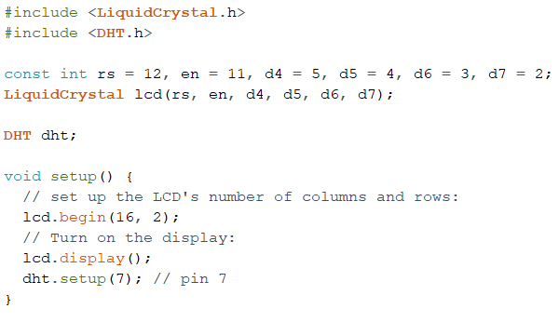
Lab 4.1 : Thermometer
You should see Temperature and Humidity showed on LCD !!!
Write this code

Slide 16
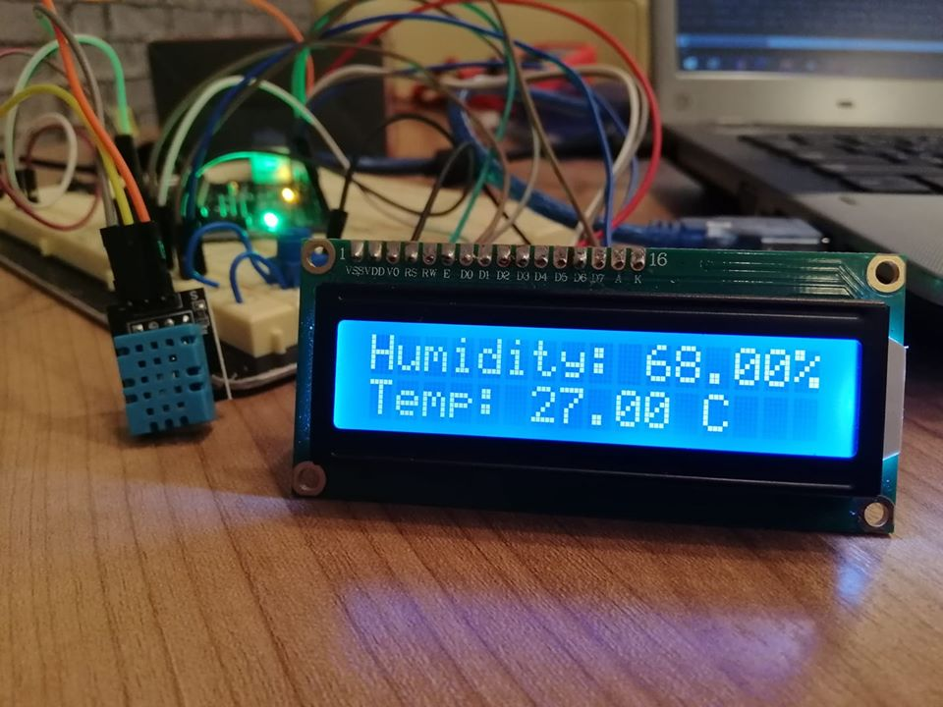
Lab 4.1 : Thermometer

Slide 17
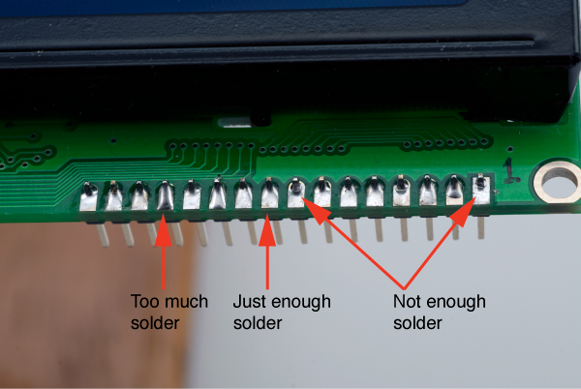
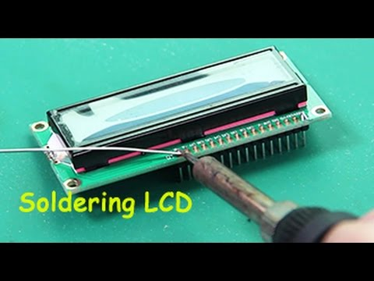
Soldering
process in which two or more items are joined together by melting and putting a filler metal (solder) into the joint.

Slide 18

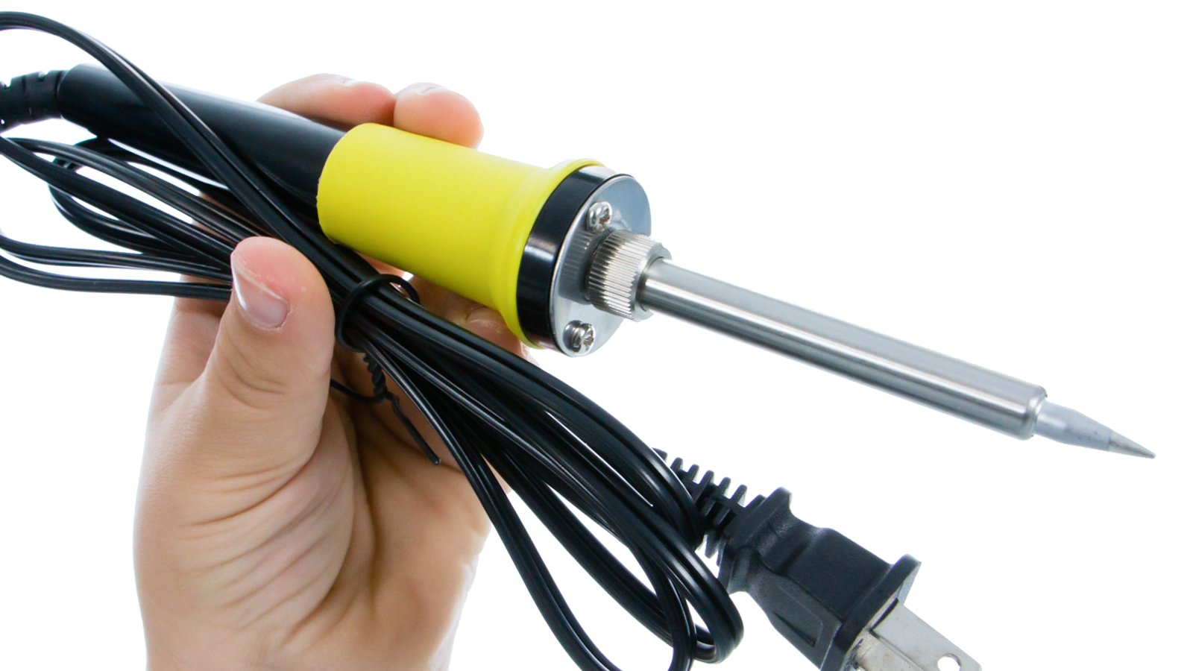
Soldering
Soldering Iron

Slide 19
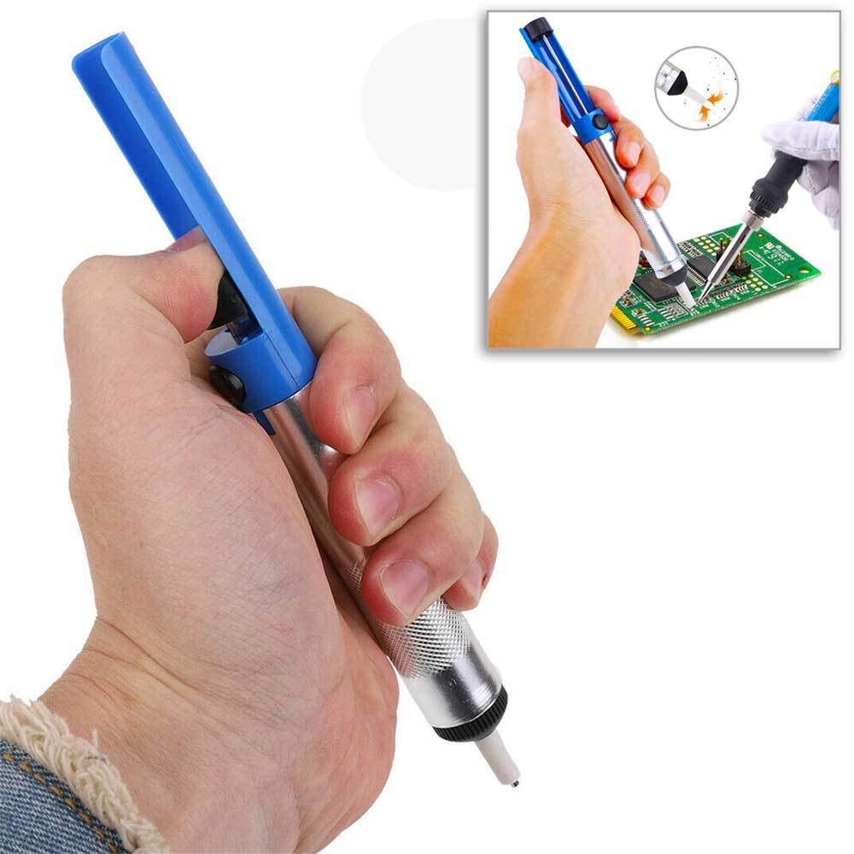
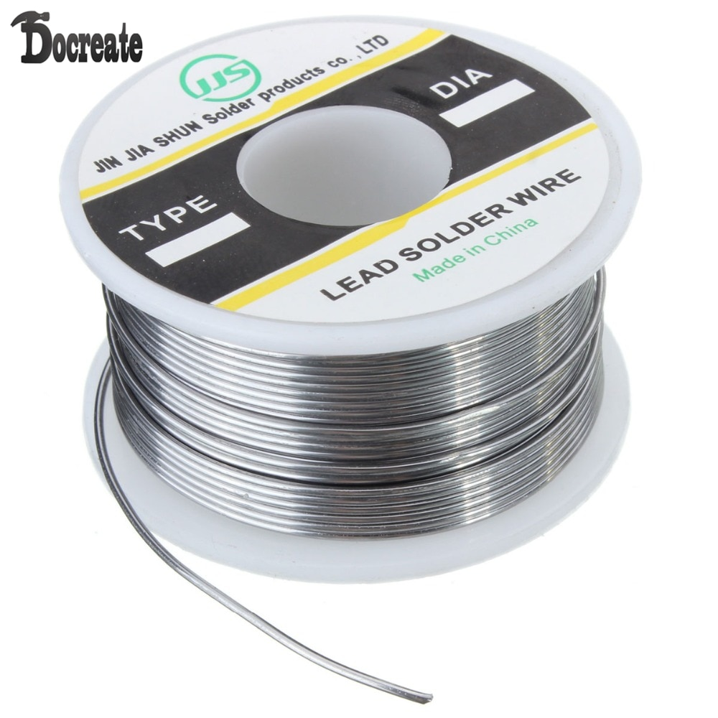
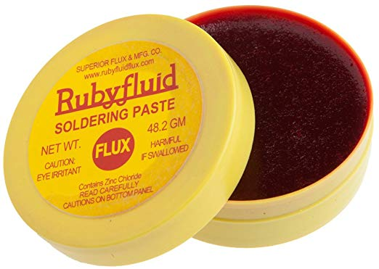
Soldering
Soldering Lead
Soldering Flex
Desoldering Pump

Slide 20

How to Do Soldering

Slide 21
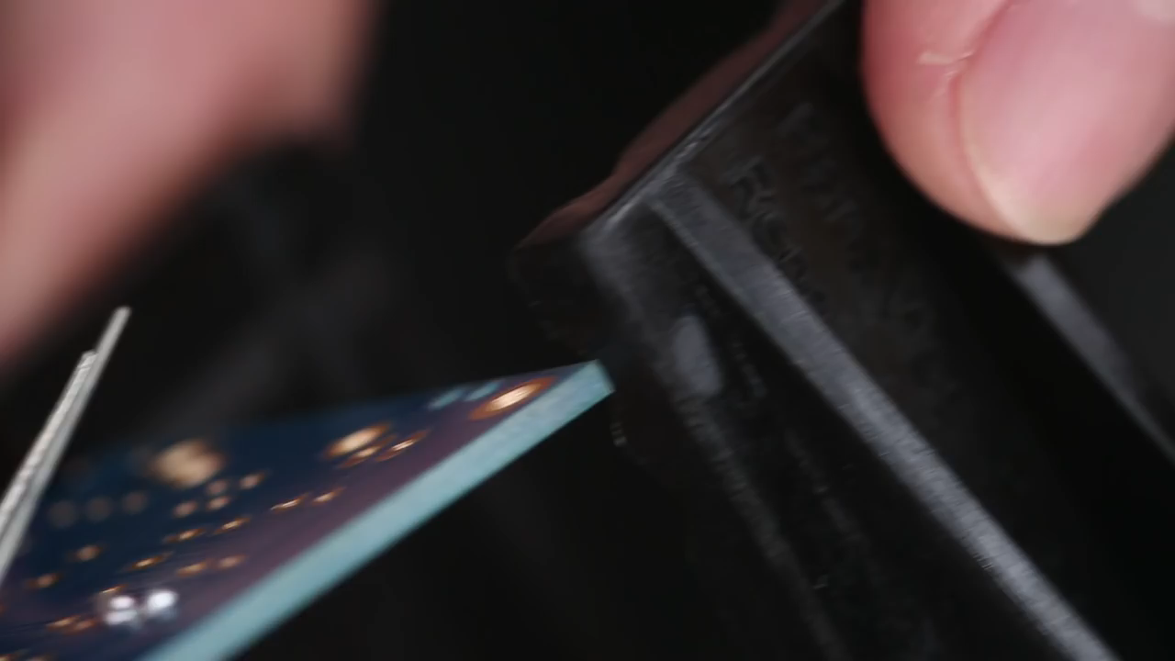
How to Do Desoldering

Slide 22
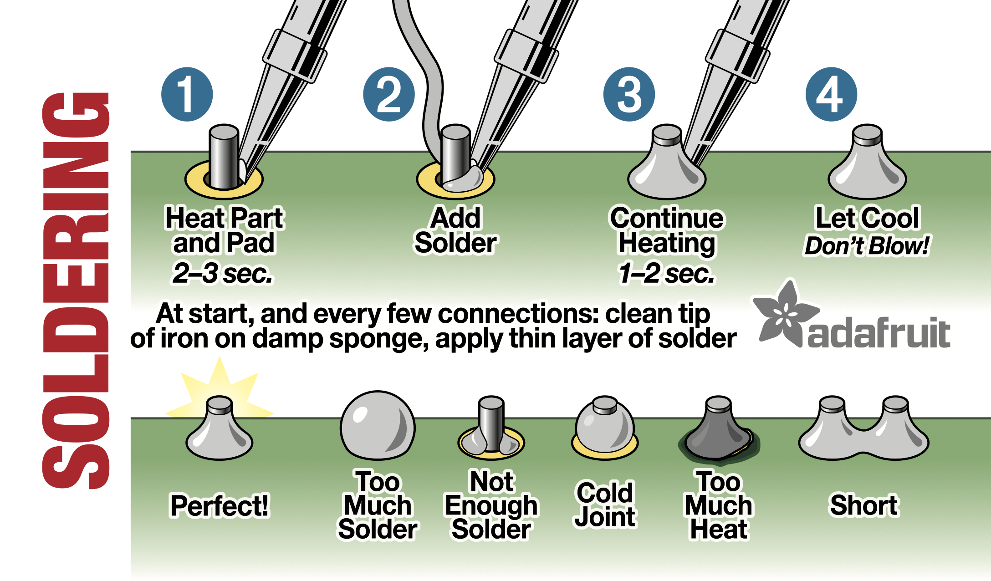
Good Soldering Point

Slide 23
Lab 4.2 : Ohmmeter
5V
GND
10k
5V
A0
GND 5V 12 GND 11 5 4 3 2 5V GND
R??
GND
Resistance
x.xx KOhm

Slide 24
Lab 4.2 : Ohmmeter
V = (5*D)/1024
Convert V to R from ohm law
Display it in LCD
Convert integer to float → float d_float = (float)D;
Convert float to string → dtostrf(val,10,2,str);
Create the sentence → sprintf();

